Slide 1
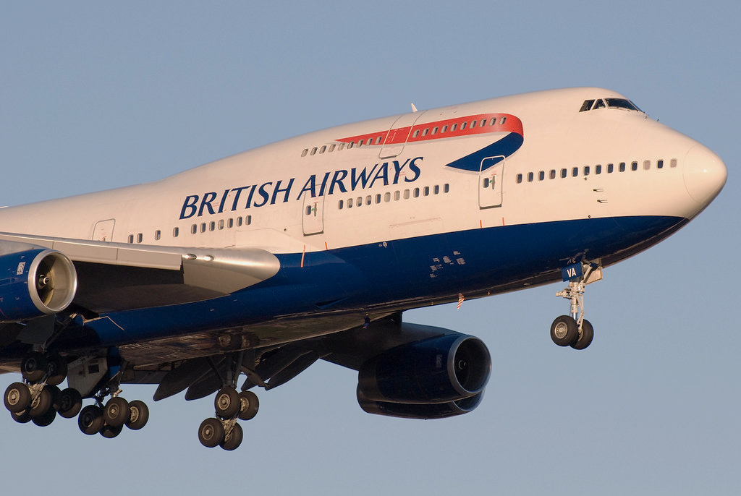
BRITISH AIRWAY REVIEWS
CUSTOMER SENTIMENTS ON THE SERVICE OF BRITISH AIRWAYS

Slide 2
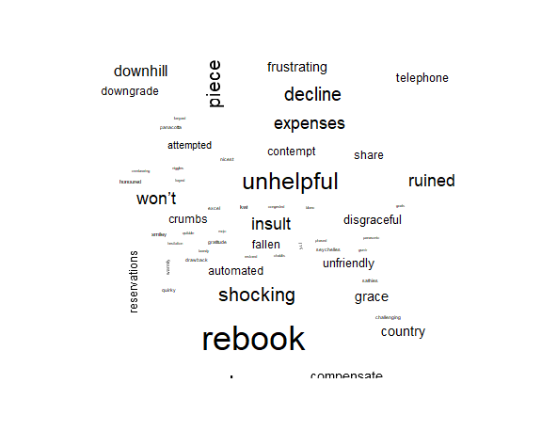
SUMMARY OF INSIGHTS
Most negative reviews seem to revolve about two major areas of contention; the business class offering and the website
Both speak to issues with refunds and customer care response time
Customers seem to not be able to clarify refunding pathways causing frustration
Strong points including seating area, luxury ambience and cleanliness
For a more in-depth look on customer sentiment concerning British Airways, check out the full analysis.
Word Cloud of most common words in the review of British Airways

